Slide 1
8253/8254 PROGRAMMABLE INTERVAL TIMER

Slide 2
INTRODUCTION
The most common problem in any microcomputer system is the generation of accurate time delays under software control.
The common software approach is to set up timing loop by moving a fixed number to a register pair and decrementing the content till it become zero. This approach unnecessarily loads CPU.
The 8253 solves these problems.
The functions which can be achieved by 8253 are:
  Event counter
  Programmable rate generator.
  Binary rate multiplier.
  Real time clock.
  Digital one shot.
  Complex motor control.

Slide 3
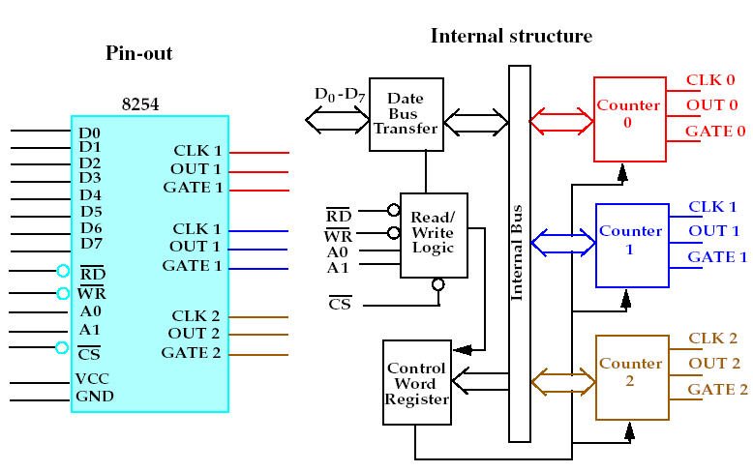
FUNCTIONAL BLOCK DIAGRAM

Slide 4
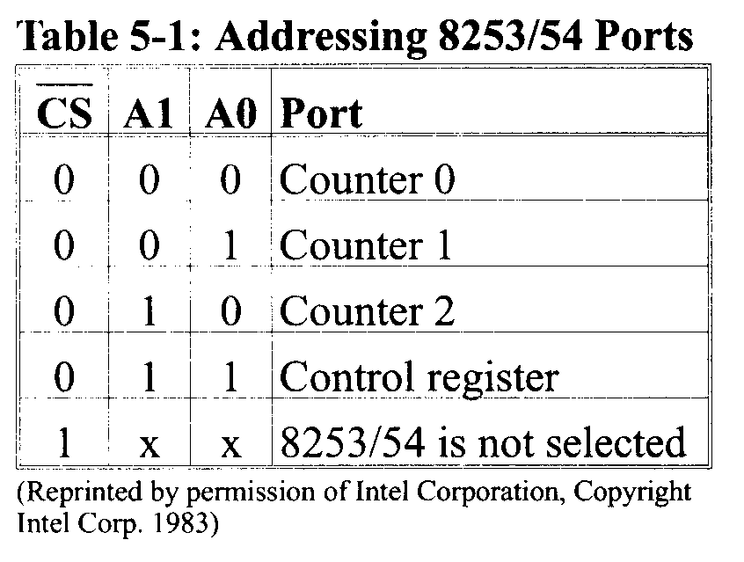
PIN DESCRIPTION OF 8253/54
A0, A1, and CS’ :
Inside the 8253/54 timer, there are 3 counters.
Each timer works independently and programmed separately.
Each counter is assigned an individual port address.
The control register common to all 3 counters and has its own port.

Slide 5
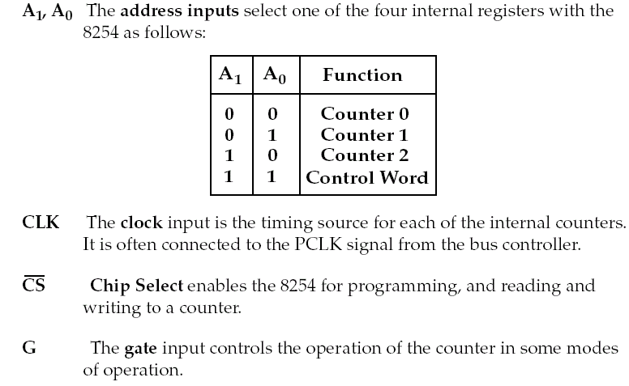
8253 / 8254 PIN DEFINITIONS

Slide 6
Each counter consists of a single, 16 – bit programmable down counter which can operate either in binary or BCD.
Each counter has 2 inputs: CLK & GATE and one output: OUT.
The input clock is fed to CLK.
For the 8253, the clock frequency is 2 MHZ or less.
CS’ | RD’ | WR’ | A1 | A0 | Selected operation
0 | 1 | 0 | 0 | 0 | Write counter 0
0 | 1 | 0 | 0 | 1 | Write counter 1
0 | 1 | 0 | 1 | 0 | Write counter 2
0 | 1 | 0 | 1 | 1 | Write Control Word
0 | 0 | 1 | 0 | 0 | Read counter 0
0 | 0 | 1 | 0 | 1 | Read counter 1
0 | 0 | 1 | 1 | 0 | Read counter 2
0 | 0 | 1 | 1 | 1 | No Operation (Tristated)
0 | 1 | 1 | X | X | No Operation (Tristated)
1 | X | X | X | X | Disabled (tristated)

Slide 7
CONTROL WORD REGISTER
8253 can operate in any one of the six different modes.
CWR is used to initialize each of the counters to decide its operations.
Each counters work independently depending upon the control word decided by the programmer as per the needs.
All counters may work in the same modes or different modes at a time.

Slide 8
